Slide 1
HOW DO YOU GET THOSE LOVELY CURVES?
Unfortunately the only curves we can draw (so far, you’ll learn more later) are graphs of functions
Today, with any decent graphing calculator, you don’t have to draw anything, it’s done for you!
Quite often, however, one has little information about itself, one has instead more specific knowledge about (like on a differential equation) and even .
So it’s helpful to know what effects the values of
Notes:
, …

Slide 2
and
have on the appearance of the graph of .
We look first at what information is provided by
Let’s make life easy for ourselves and make (just for this lecture! ) the following basic assumptions about :
It is continuous wherever defined.
It is differentiable at any point inside some open interval
where it is defined.

Slide 3
OK, here we go: let (says nothing)
Theorem. Let . Then
implies
is increasing on .
implies
is decreasing on .
Proof. (Easy application of the Mean Value Theorem) Pick two points and , both inside , with . Then, by the MVT

Slide 4
which proves 1. Also
which proves 2.
The theorem gives us an easy way to check if a point , where , is a local maximum or a local minimum. It is based on two simple observations:
If you are standing …
At the bottom of a valley the ground comes down on one side and goes up on the other.
At the top of a hill the ground comes up on one side and goes down on the other.

Slide 5
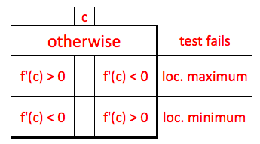
Using the derivative we get what is known as (simple idea, big name) the First Derivative Test:
Let . The following table holds:

Slide 6
Clearly, in order to sketch a graph of , it helps to know where the function is increasing and where it is decreasing.
The theorem tells us that we must find where the first derivative is positive and where it is negative.
Therefore, In order to find where the function
is increasing or decreasing we simply compute the derivative and
Find where it is 0 or undefined, say
Find its sign between two consecutive and apply the theorem.

Slide 7
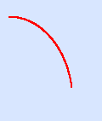
One last geometric notion is needed before we can draw all those beautiful curves. We know by now what it means for a curve to go up
and down . But …
there are two ways to go down

Slide 8
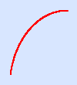
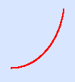
and two ways to go up:
How can we tell them apart? Looking again at the pictures we get the four figures

Slide 9
In the first and third figures the curve is always
above its tangent
In the second and fourth ones the curve is always
below its tangent

Slide 10
The “above” case is called “CONCAVE UP”
The “below” case is called “CONCAVE DOWN”
To tell them apart we observe that in the “UP” case the slope of the tangent is going up, while
In the “DOWN” case the slope of the tangent is going down. Therefore
In the UP case the first derivative is increasing
In the DOWN case the first derivative is de-creasing
If we are lucky enough to have a second deriva-tive we get the table I will show on the board.

Slide 11
One more piece of terminology to be learned:
As usual, let
A point
is called a critical point (critical number, doww) if one of the following four conditions holds:
(the end-points, if any, may be included, doww)
Now we make the table (should look like …)

Slide 12
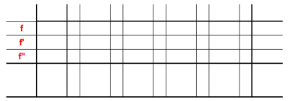
… this:
and from the table we
DRAW !!
(If something does not fit
we have made an error!)

Slide 13
One LAST bit of terminology:
Let and such that …
passing through the concavity changes orien-tation (from UP to DOWN or from DOWN to UP).
In this case we call an “inflection point”
(or inflection number, doww)
an example
Now go draw !! ☺

